Slide 1
Understanding the Rise in Corporate Cash: Precautionary Savings or Foreign Taxes
Michael W. Faulkender, Kristine W. Hankins, and Mitchell A. Petersen (2019)
Presented by Nicholas Thompson

Slide 2
Research Question
What factors have driven U.S. multinational corporations (MNCs) to significantly increase cash holdings?
Specifically, is this increase driven by precautionary savings or foreign taxes?

Slide 3
Prior Literature
Precautionary savings:
Earlier work focused on measuring firms’ access to capital markets (Opler et al., 1999).
More recent work focuses on role of increasing investment uncertainty (Martin & Santomero, 1997; Boyle & Guthrie, 2003; Bates, Kahle, & Stulz, 2009; Harford, Klasa, & Maxwell, 2014).
Foreign taxes:
Firms’ objective to minimize present value of taxes may result in a buildup of cash in foreign subsidiaries—“trapped cash.”
Foley et al. (2007) show that lower foreign tax rates are associated with higher total and higher foreign cash.
Notes:
High access to capital markets / low investment uncertainty → firm holds less cash

Slide 4
Data
Period: 1998 to 2008
BEA surveys (BE-10 and BE-11): Non-public surveys with detailed financial data on foreign subsidiaries of U.S. MNCs
Compustat: Firm-level financial data
Full sample: 78,336 firm-year observations
BEA sample: 13,153 firm-year observations

Slide 5
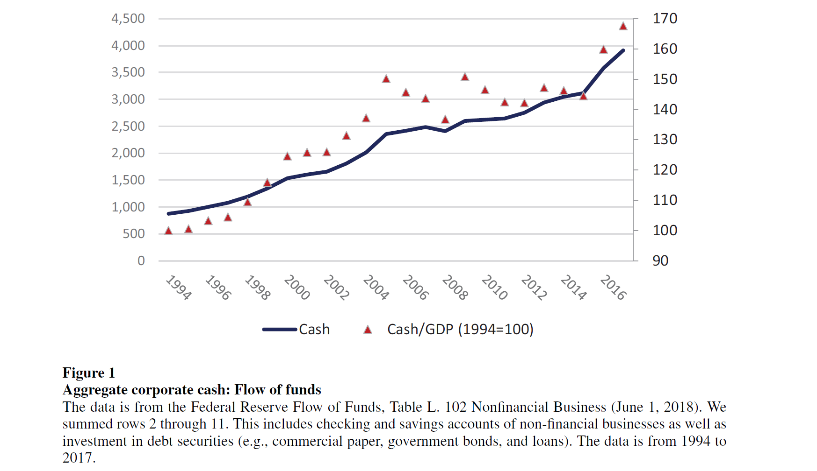

Slide 6
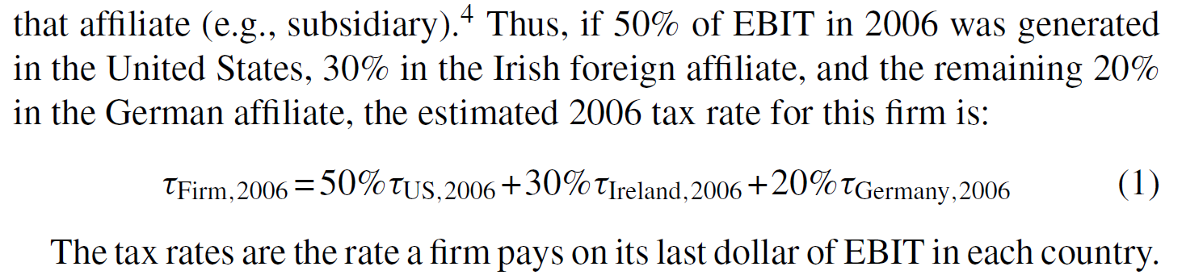
Notes:
As this weighted average rate declines, we would expect the firm to hold more foreign cash because the realized deferral benefits are greater.

Slide 7
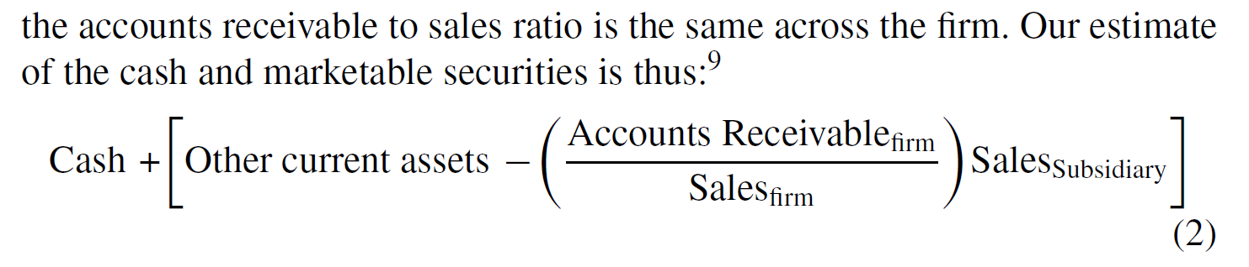
Notes:
In the annual surveys, we must estimate marketable securities by subtracting an estimate of accounts receivable from other current assets.

Slide 8
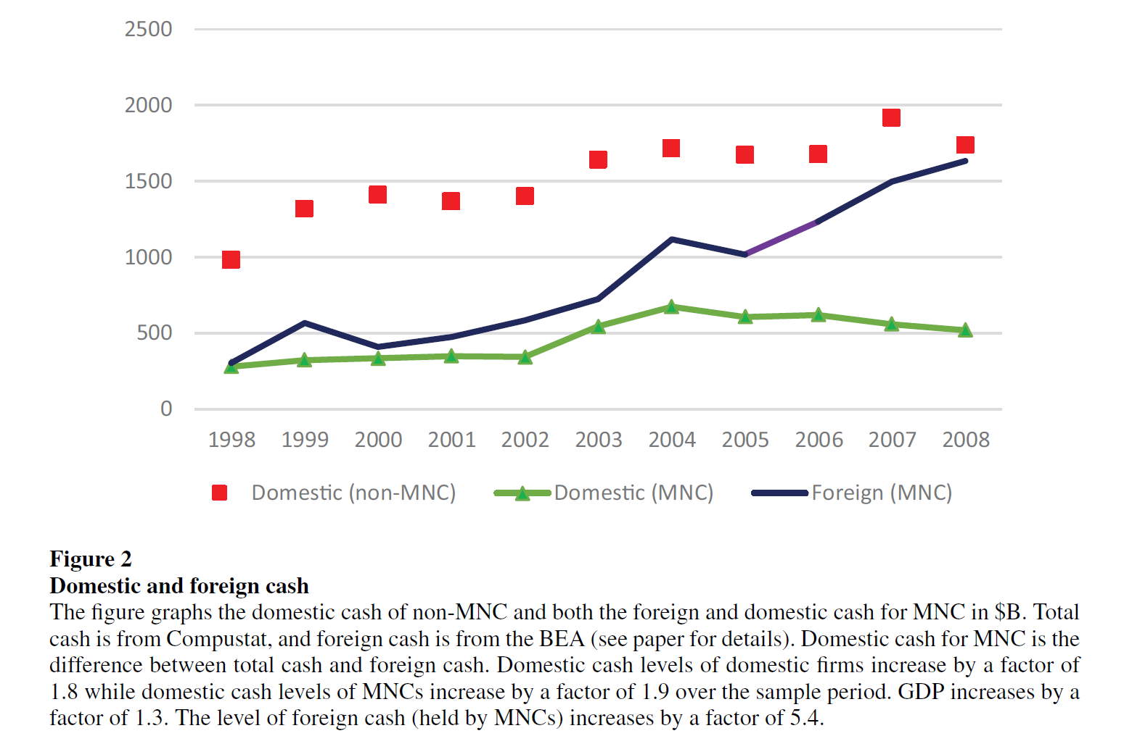
Notes:
The rise in foreign cash of MNCs has been much greater than the rise of domestic cash (in either domestic firms or MNCs).

Slide 9
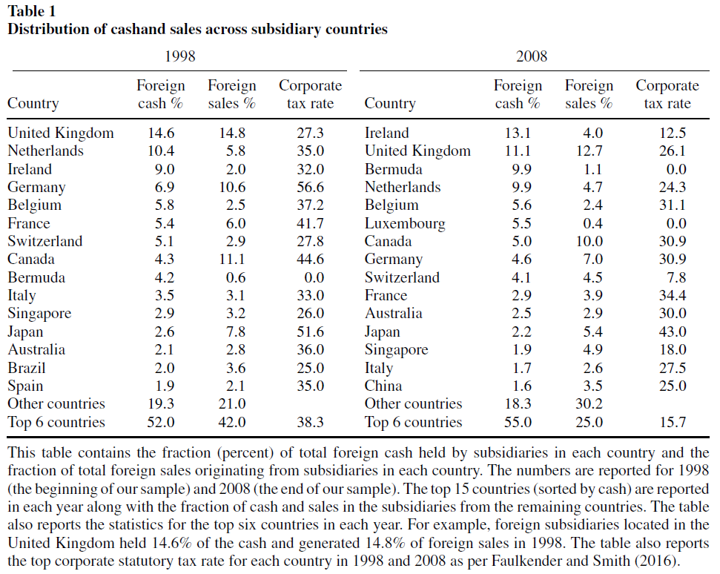
Notes:
The correlation between sales and cash weakens from 1998 to 2008.
Part of the shift between 1998 and 2008 was caused by firms increasing their stockpile of cash in countries that had low tax rates even in 1998. Foreign tax rates also declined relative to U.S. rates.

Slide 10
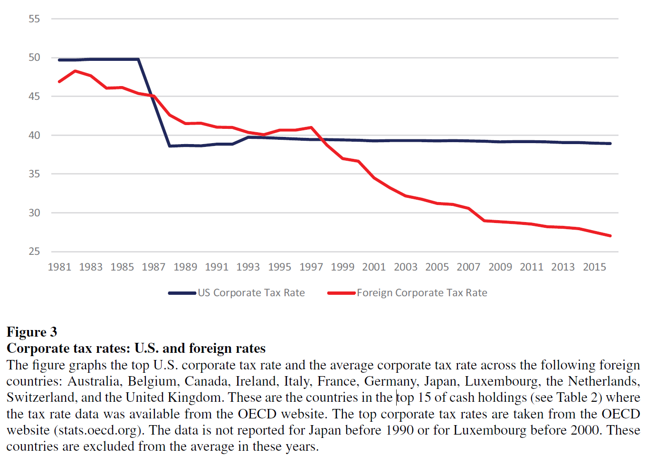
Notes:
As tax rates have fallen in many foreign countries relative to the U.S., the incentive to earn income in foreign subsidiaries has risen. As a result, cash builds up in the firm’s foreign subsidiaries.

Slide 11
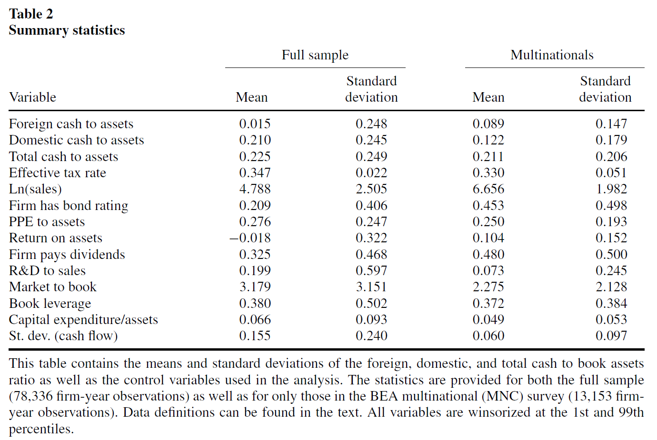
Notes:
Total cash to assets is approximately the same. The MNCs have significantly higher foreign cash and less domestic cash.
MNCs are also larger, more profitable, more likely to pay dividends, more likely to have access to the bond market, have less-volatile cash flows, and invest less in capex and R&D. These firm characteristics are normally associated with greater capital market access, not less. The average MNC is not a capital-constrained firm, yet these firms are responsible for most of the rise in cash.

Slide 12
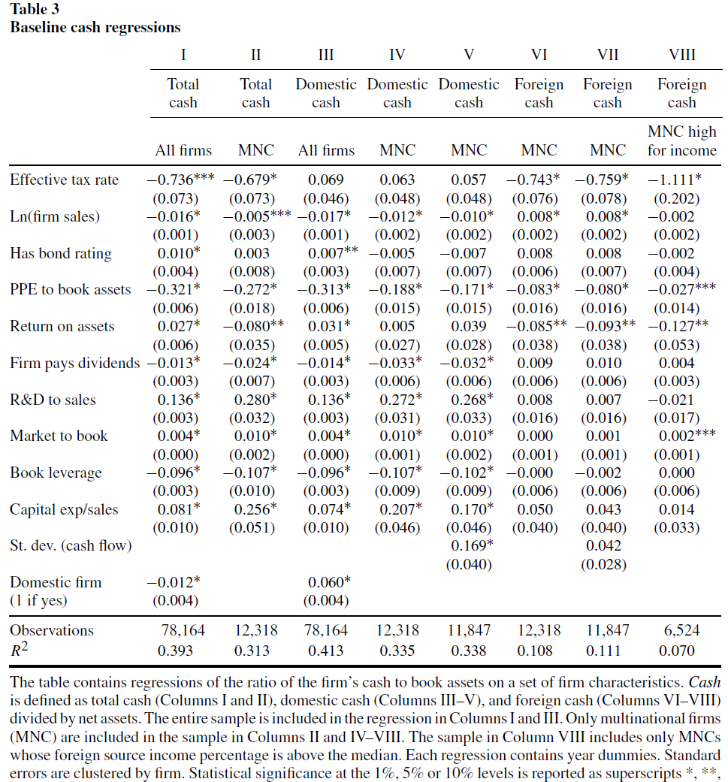
Columns I and II show that firms that should have greater access to the capital markets (are larger and have greater asset tangibility [higher PPE/book assets and lower market to book ratio]) and invest less and or/return more capital to investors (lower R&D, lower capex, and higher dividends) hold less cash. Traditionally, these results have been interpreted as consistent with the precautionary savings motivation.
Columns III, IV, and V similarly support the precautionary savings motivation for domestic cash positions.
However, Columns VI, VII, and VIII show that the precautionary savings variables have little predictive power in explaining foreign cash positions.

Slide 13
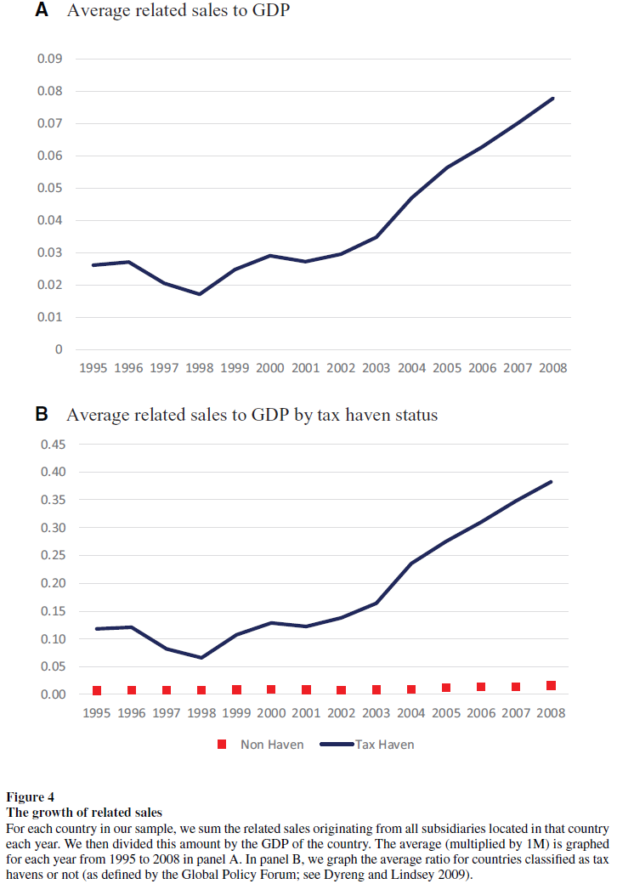
Notes:
Related sales started to grow faster than the country’s economy beginning in 1999. This corresponds to timing of check-the-box regulation, which facilitated income shifting.
If we divide the sample into countries that are classified as tax havens and those that are not, the growth in related sales (relative to the economy) is concentrated exclusively in the tax haven countries.

Slide 14
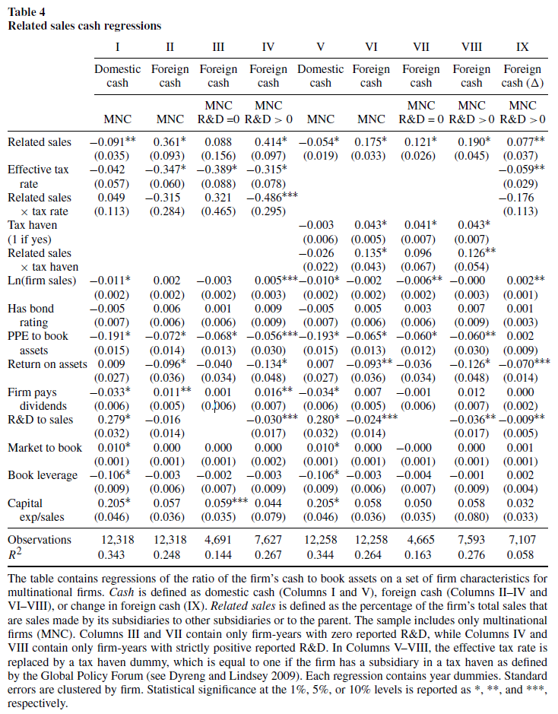
Firms with higher related sales and lower effective tax rates hold more foreign cash, consistent with a tax avoidance story. This is especially true for firms that spend on intellectual property (R&D).

Slide 15
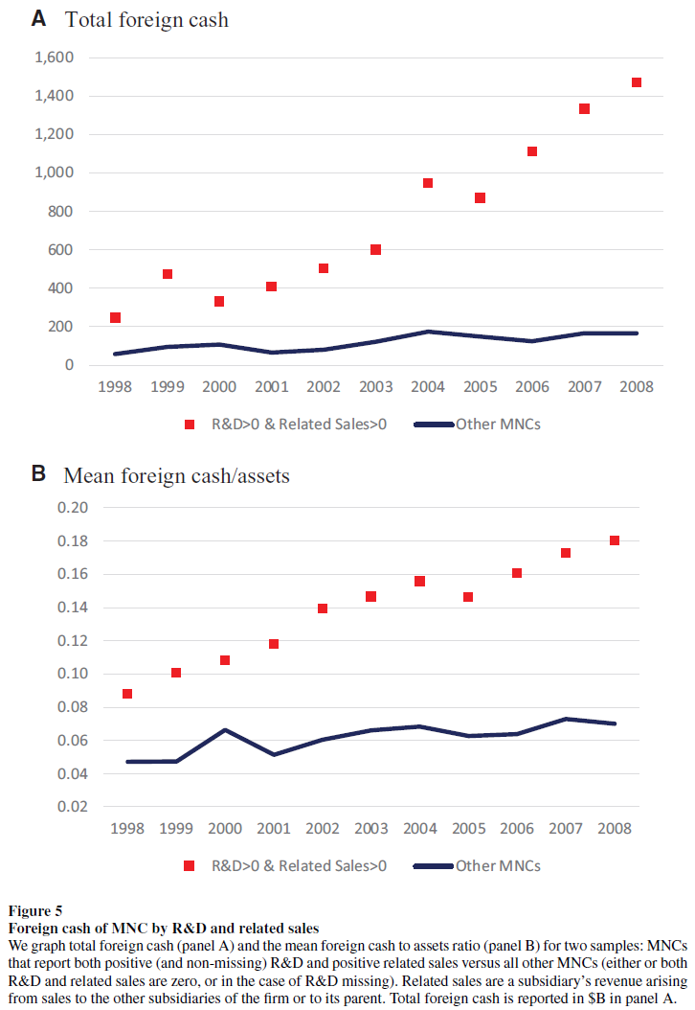

Slide 16
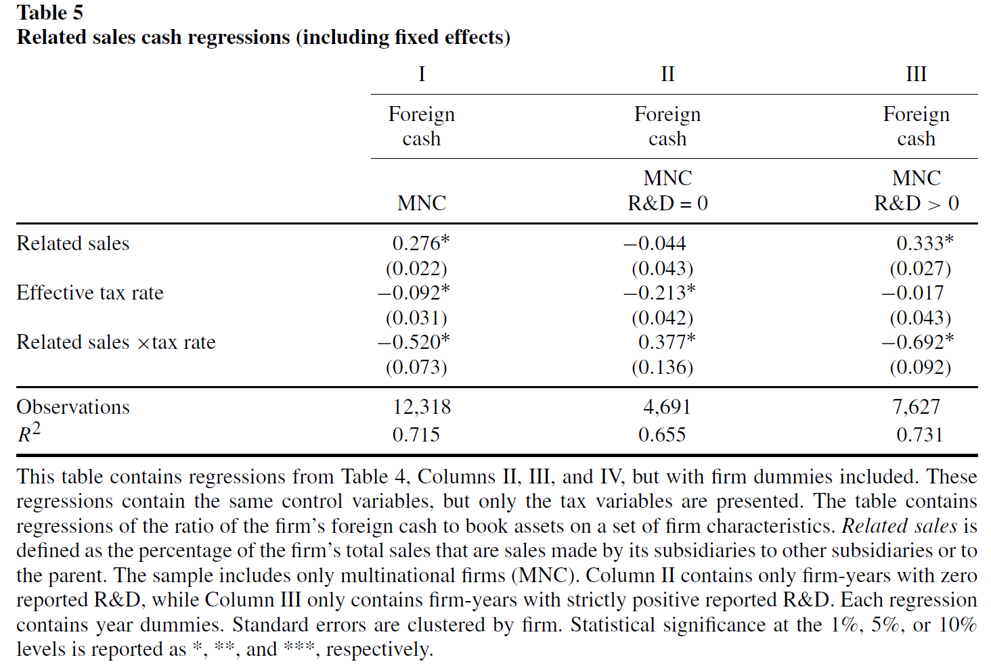
Notes:
Same as Table 4 but with fixed effects

Slide 17
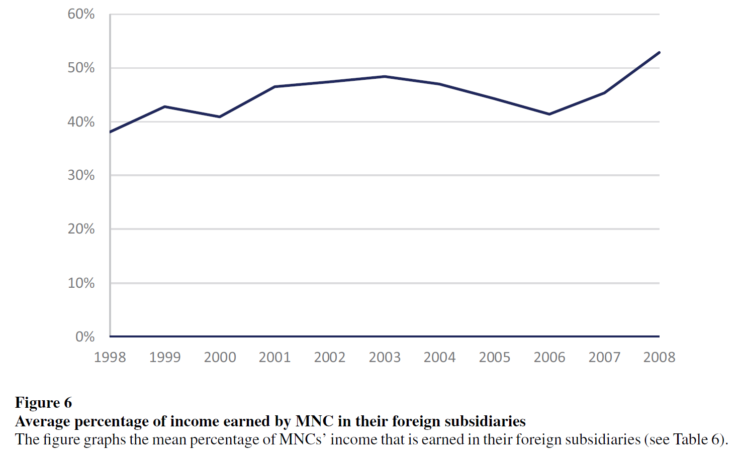
Notes:
The mean fraction of income earned abroad has risen from 38% to 53% over our sample.

Slide 18
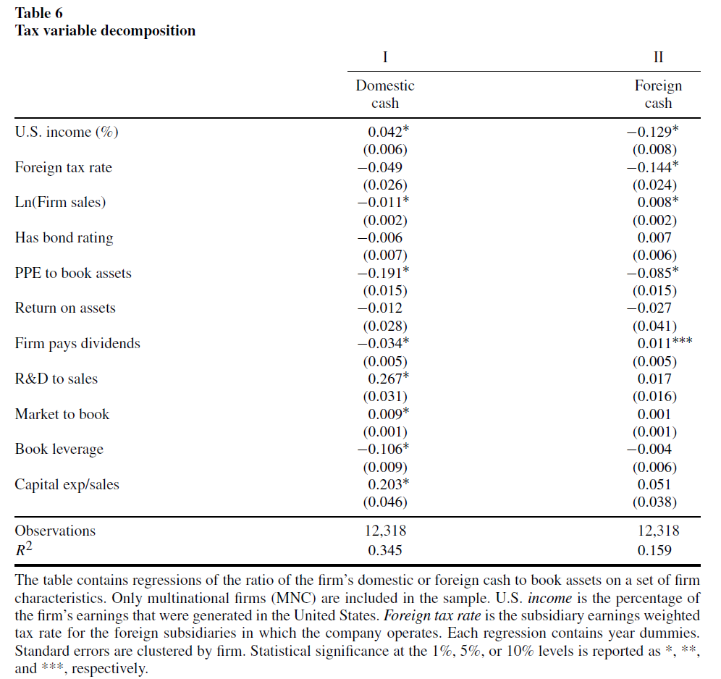
Notes:
We see that income is sticky; cash tends to be held where it is earned.
Decreasing the foreign tax rate increases the amount of foreign cash that MNCs hold but has no statistically significant effect on domestic cash.

Slide 19
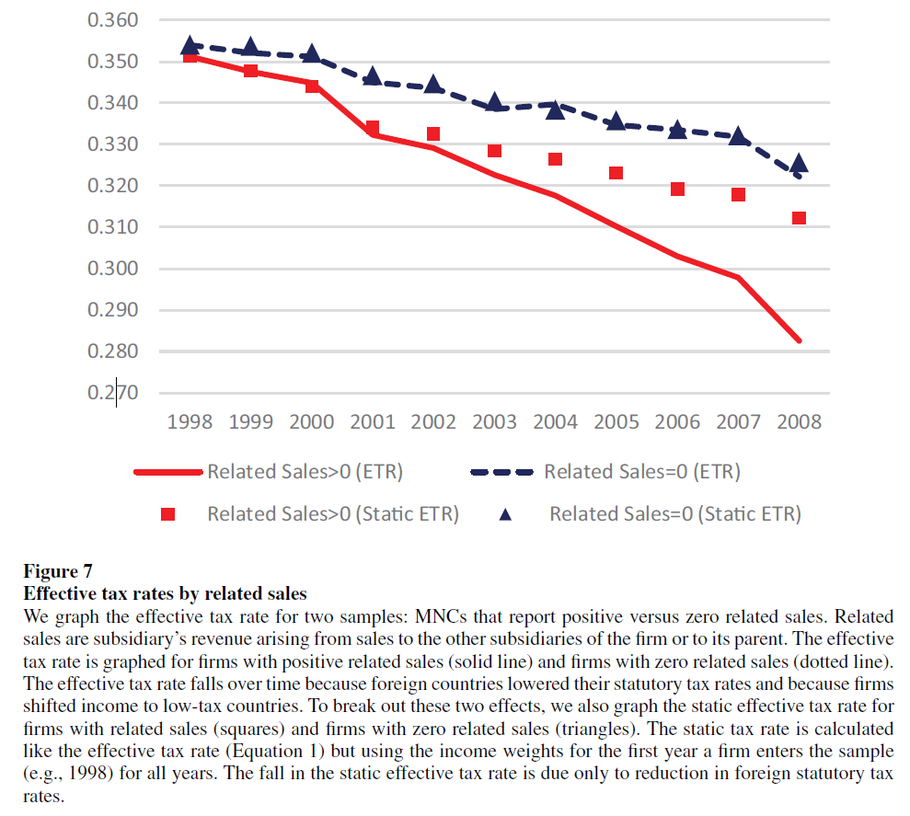
Notes:
Changes in the static effective tax rate measure only changes in foreign tax rates in countries where the subsidiaries were initially located. For firms with no related sales, the static and (dynamic) effective tax rate are the same (compare the dashed line to the triangles). These firms do not shift income toward low-tax jurisdictions.

Slide 20
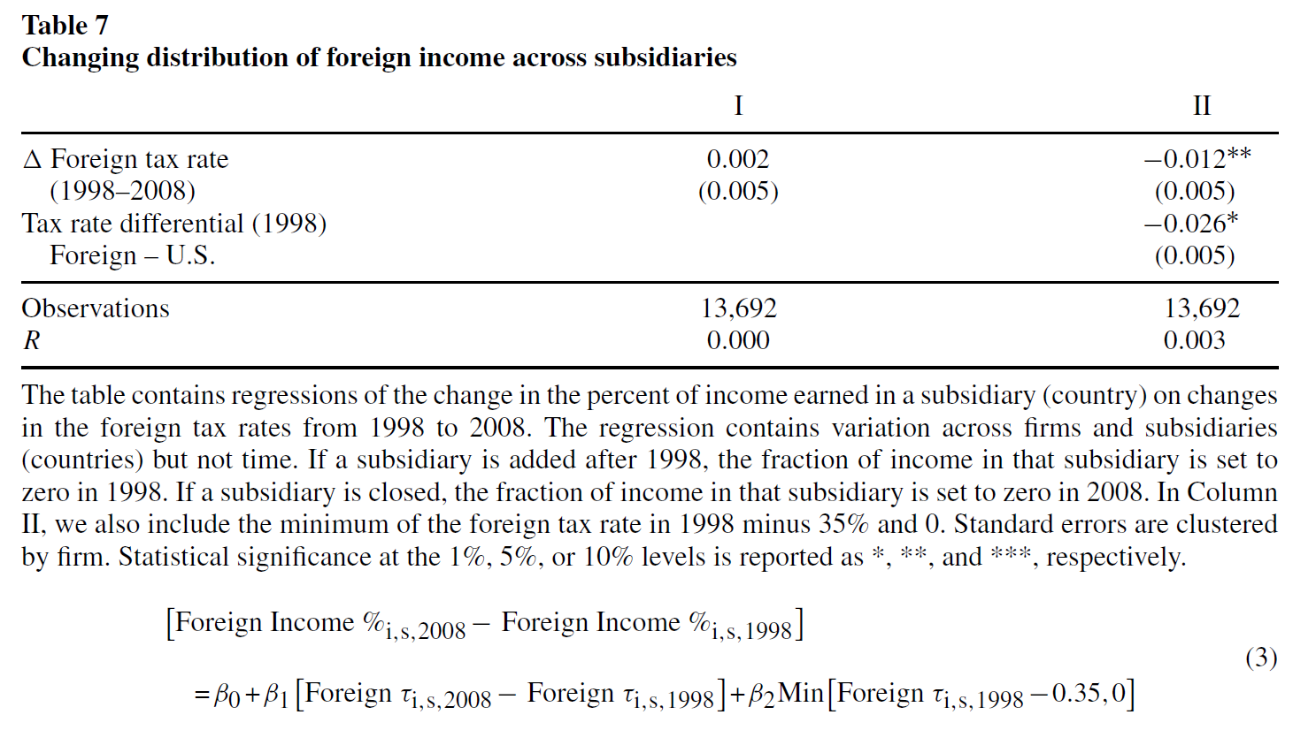
Notes:
Firms increased the fraction of income earned in a country between 1998 and 2008 when the foreign tax rate was initially further below the U.S. rate. With this additional control, we find a statistically significant coefficient on the change in the tax rate.

Slide 21
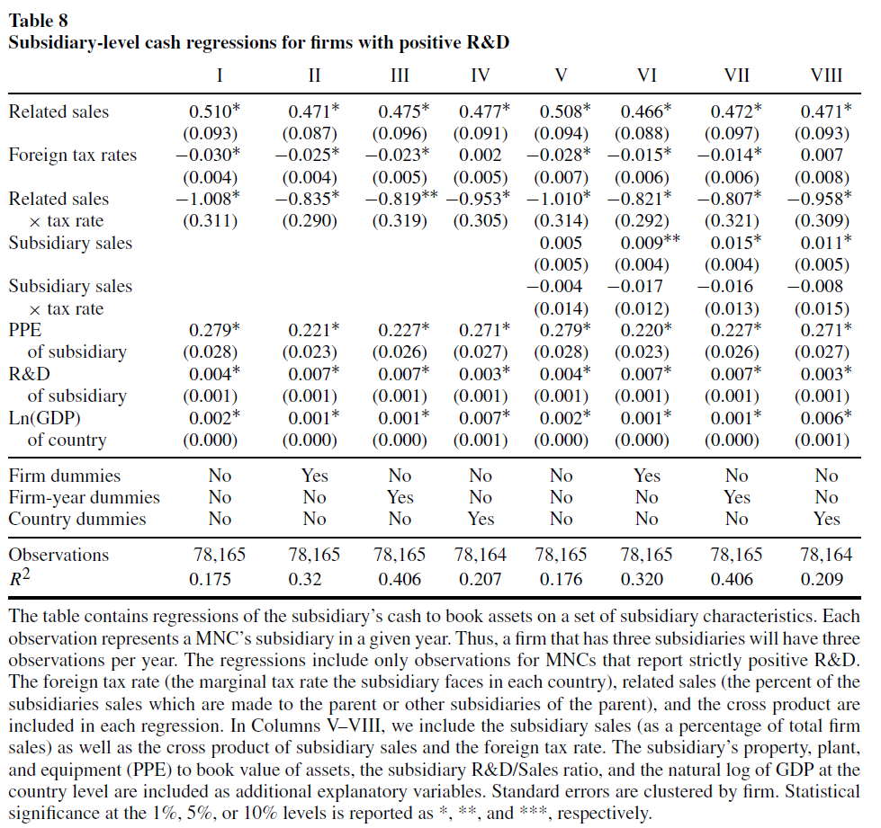
Notes:
The lower the country tax rate, the more cash a firm holds in that subsidiary. The higher the fraction of subsidiary sales to other subsidiaries or to the parent (related sales), the more cash held in the subsidiary.

Slide 22
Conclusion
The rise in corporate cash is almost entirely due to an increase in foreign cash, not domestic cash.
Foreign tax rates and ability to shift income to low-tax jurisdictions explain most of rise in foreign cash holdings.
Firms with significant intangible assets are better positioned to shift income to low-tax jurisdictions.
Precautionary savings explain domestic cash but have little to no role in explaining foreign cash accumulation.

